Slide 1
EURELECTRIC Manifesto
Power for a Competitive Europe

Slide 2

Reaching the EU objectives
  Cost-effective decarbonisation by 2050
  A competitive Europe underpinned by sustained economic growth
  Innovation
The start of a marathon!

Slide 3
The EU power sector takes on a leading role through investments
that are clean, smart and sustainable
that ensure affordable, competitive and secure energy supplies
  Electricity products and services drive economic growth, creating jobs and prosperity

Slide 4

EU energy and climate policies should provide direction
Enabling a consistent and stable framework
Ensuring an enabling investment climate (€1 trillion)
Setting out core objectives (not necessarily policy instruments!)
Taking a system approach: from customers to generation to grid companies

Slide 5

However, the run is not going smoothly
The low-carbon transition is more costly than need be
Wholesale prices are stable, but prices for households and business are skyrocketing
The value of power companies is deteriorating
D. Political and regulatory uncertainty are hampering investment

Slide 6
A. The transition towards the low carbon economy is more costly than necessary
Average RES unit support at 69.7 EUR / MWh
Europe-wide ETS but 28 incompatible national support schemes
Support totalling 26.3 bn EUR in 2011*
SOURCE: EURELECTRIC

Slide 7
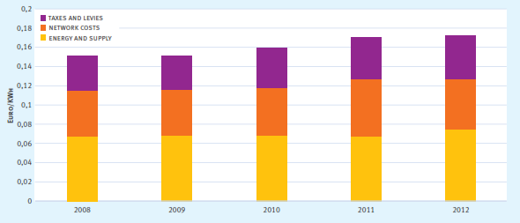
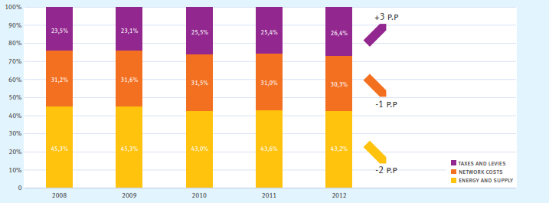
B. Customer prices are rising
Retail customers are not reaping the benefits of falling wholesale prices as the part of the bill set by market forces has shrunk
SOURCE: EURELECTRIC

Slide 8
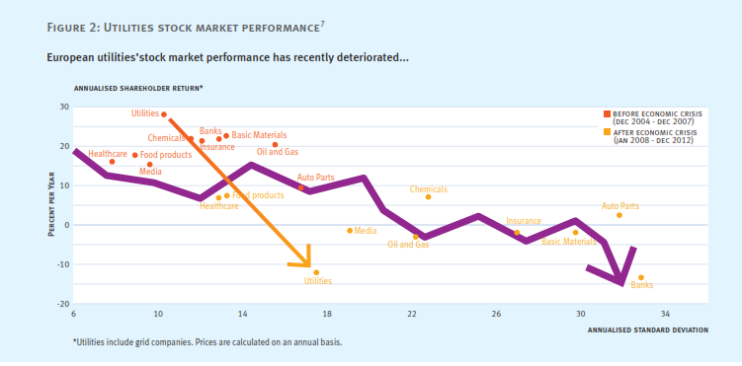
C. Utilities are underperforming
SOURCE: EURELECTRIC

Slide 9
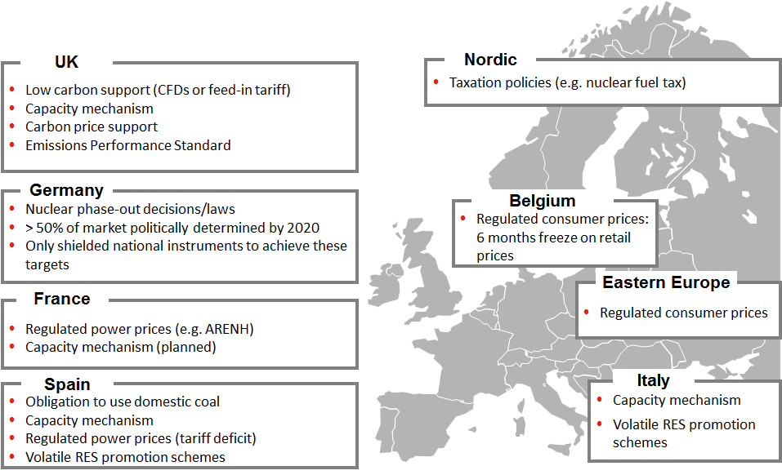
D. The lack of a European approach is hampering investment
SOURCE: EURELECTRIC

Slide 10

EURELECTRIC’s manifesto gives the runner direction and an energy boost
Pursue decarbonisation via strong GHG reduction target + ETS reform
2. Secure supply through competitiveness and innovation - revisit our market environment
3. Empower our customers

Slide 11

1. Pursue decarbonisation via strong GHG reduction target + ETS reform
Adopt an economy-wide, binding 2030 GHG reduction of at least 40%
Strengthen the ETS cap
Promote the use of electricity in transport, heating and cooling

Slide 12
1a Adopt an economy-wide, binding 2030 GHG reduction of at least 40%
EURELECTRIC commits to:
Combat climate-change:
Carbon-neutral electricity by 2050;
Boost energy efficiency by electrifying transport, heating/cooling…
Deliver cost-efficient, reliable electricity:
European, market-based solutions
Climate policies must be cost-effective, this requires
Focus on emissions reduction (not renewables, imports)
Economy-wide targets (not just a few sectors)
EU-level instruments (not national)
Market instruments (not command)
A steady pace of change (early + high ambition, not delay + low ambition; stable framework, not stop/start)
…do not replicate the 20/20/20 package

Slide 13
1b Strengthen the ETS cap
The ETS annual linear reduction factor should increase from -1.74% to -2,3% before 2020, assuming no set-aside
Current EUA: -1,74% pa
Required EUA: -2,3% pa
SOURCE: EURELECTRIC

Slide 14
1c Promote use of electricity in transport, heating and cooling
- Extend the use of electricity in other CO2 emitting sectors after 2020 (transport, heating and cooling)
- Review the conversion factor used in the Energy Efficiency Directive
SOURCE: EURELECTRIC

Slide 15

2. Secure supply through competitiveness and innovation - revisit our market environment
Integrate renewables into the market
Generation adequacy should be assessed at least at regional level
Market integration needs a serious boost
Promote competitive and flexible gas markets
Promote innovation
Adequate network infrastructure

Slide 16
2a Integrate RES into the market
Operational aspects of integration
Economic aspects of integration
Source: EURELECTRIC, CEER – Status Review of Renewable and Energy Efficiency Support Schemes in Europe.
Notes:
Much like the support schemes themselves, the support
amounts vary widely across the EU. The following graph displays
the aggregated cost of RES support in 19 EU countries, totaling €26.3bn* in 2010 and reaching €38bn** in 2012.
-

Slide 17
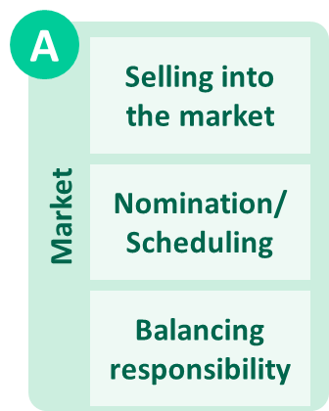
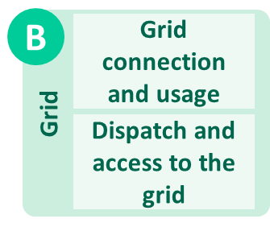
2a All generators should sell their production to the market and carry out the same obligations
Same rules for both RES and conventional generation!
SOURCE: EURELECTRIC

Slide 18
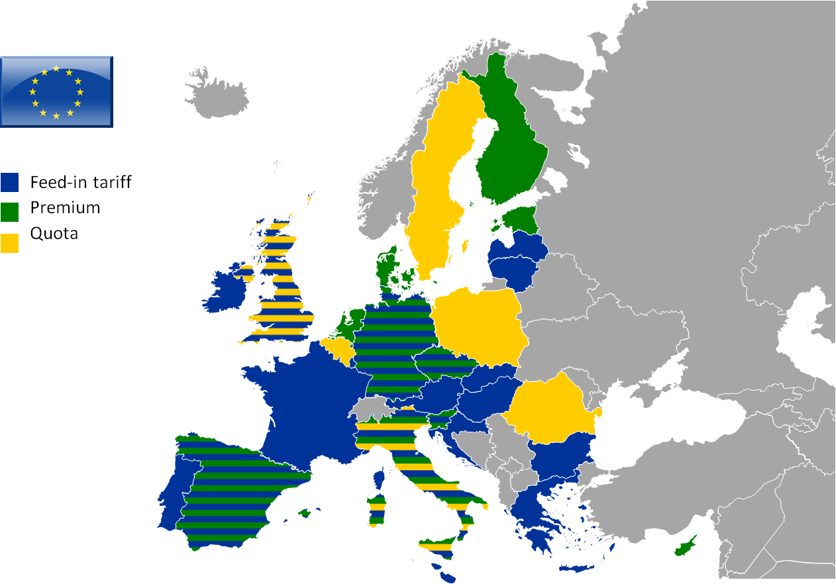
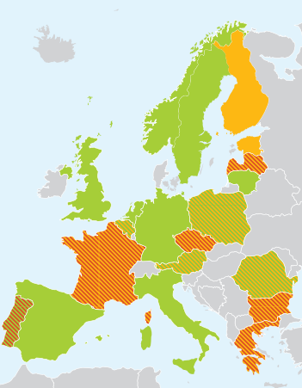

2a Progressively phase out support moving to 2020 and beyond
Huge amount of RES-E support schemes
Overcompensation passed on to consumers
- RES support changes in Europe
SOURCE: EURELECTRIC
Notes:
Only immature technologies could continue to receive specific support in their research, development and deployment phase and following strictly defined requirements.
For that purpose, a definition for mature and immature technology should be developed.
Existing commitments directly related to the support renewables must be respected until the foreseen time horizon.
Not the case today: 13 EU member states have opted for retroactive changes or moratoria to their RES support schemes

Slide 19
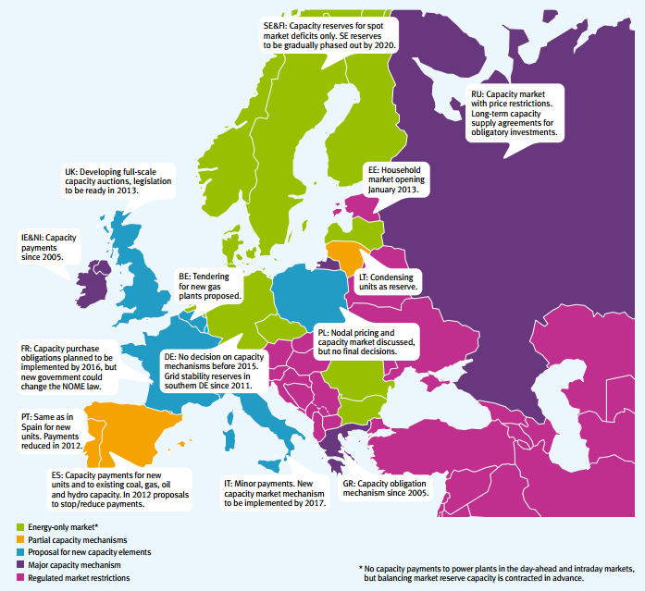
2b Generation adequacy should be assessed at least at regional level
Where implemented, capacity remuneration mechanisms need regional/EU coordination
They should be
  Market based
  Technology neutral
  Non-discriminatory
SOURCE: EURELECTRIC
Notes:
Generation adequacy should be assessed at least at regional level to avoid major market distortions.
Capacity remuneration mechanisms, where implemented, need meaningful regional/EU coordination,
And should be market-based, technology neutral and non-discriminatory.
CRMs should only be introduced as a means of ensuring generation adequacy, not to achieve other objectives, such as level of CO2 or flexibility) and, in any case, should be considered as a payment to ensure firmness of electricity supply, and thus, should not be regarded as a subsidy.
The Commission should set up a proper governance process to coordinate various CRM projects and ensure their convergence in a longer term, in particular in most Continental Europe where this review of the market design is needed.

Slide 20
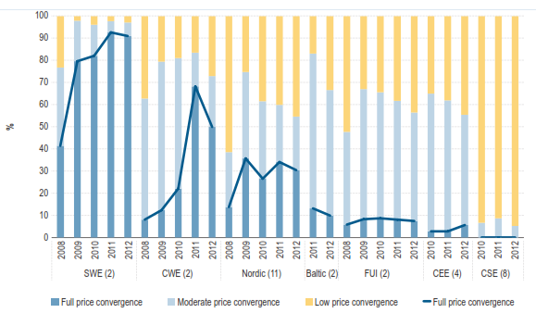
2c Market integration process needs a serious boost…
Wholesale markets:
  Significant scope for further price convergence
  Growing congestion related to RES in particular
Speed up the implementation of the 3rd package
Encourage coupling of regional markets based on a clear roadmap
Price convergence in Europe by region (%) Source: ACER Market Monitoring Report 2013
Notes:
ACER cross-border regional roadmaps together with ACER Stakeholders Electricity Advisory Group are the foundation of the integration process
Delay in achieving price coupling within the NWE (go-live scheduled for beginning of November 2013), robustness still to be tested

Slide 21
2c … in order to achieve the target of the integrated European energy market by 2014
Illustrative network codes
development schedule
SOURCE: ENTSO-E
  Implement the target models for the integration of day ahead, intraday and balancing markets
  Develop relevant EU network codes
  Clear commitment for selecting an intra-day platform is needed
  Ensure convergence of balancing markets in Europe
Notes:
Significant delay in selecting an intra-day platform: the intraday platform can be achieved if clear commitments and deadlines are placed on TSOs and PXs and made binding/enforceable in the NC CA CM
Ensure convergence of balancing markets in Europe
TSOs should not be granted a right to offer balancing services

Slide 22
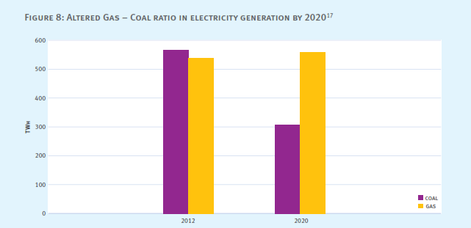
2d Promote competitive and flexible gas markets
Promote diversification of gas supply
Complete the internal gas market as well as the necessary investments to enhance the flexibility of the physical system
Predicted Coal to Gas Switch by 2020
  Reverse trend by 2020: 560 TWh gas and only 307 TWh
SOURCE: EURELECTRIC
Notes:
Current Trend:
coal prices dropped by one third, insignificant CO₂ price of €4
stagnating gas prices.
Predicted Trend:
Industrial Emissions and Large Combustion Plant directives, newly
established capacity markets supportive to gas, no significant
influence of CO₂ price.

Slide 23

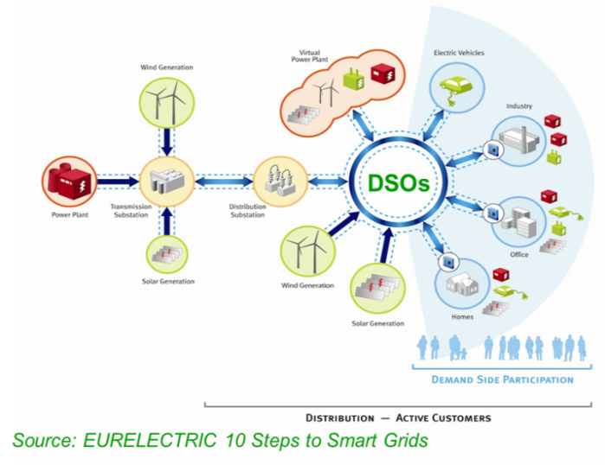
Competitive and flexible markets to help ensure smooth integration of RES
Flexible
generation and storage
Demand-Response and Smart Grids

Slide 24
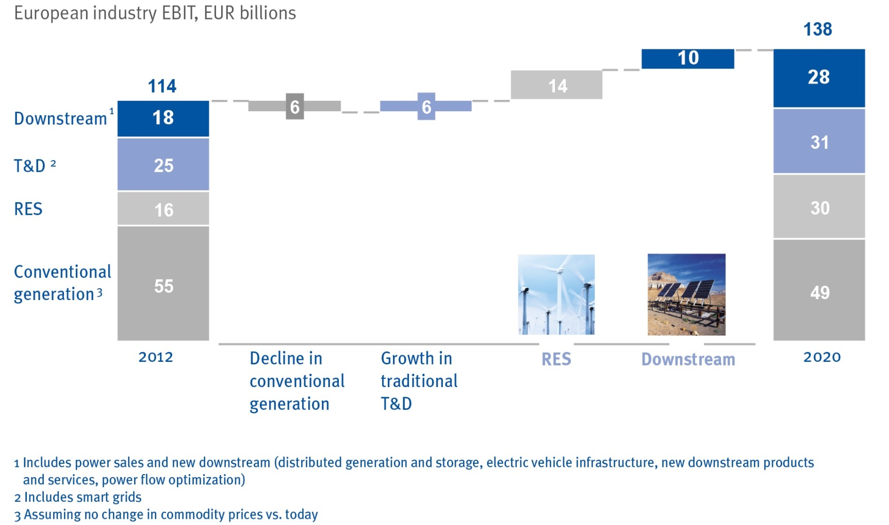
2e Promote innovation in technologies, products, services and business models
1
2
Source: McKinsey Industry vision team analysis
Notes:
- Full value chain
- Systems approach

Slide 25
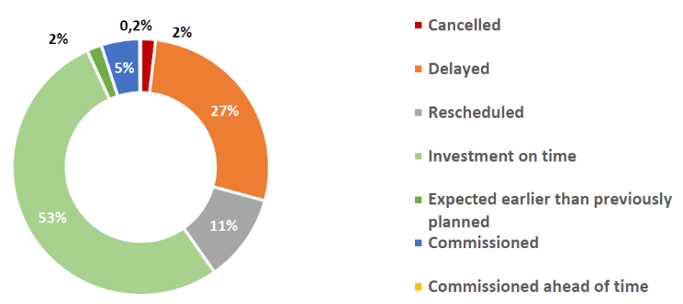
2f Adequate network infrastructure: transmission
Increasing interconnections are required:
  TYNDP 2012: more than 100 pan-European projects for € 100 billion in next 10 years
Monitoring update of TYNDP 2012 (June 2013 status) SOURCE: ENTSO-E

Slide 26

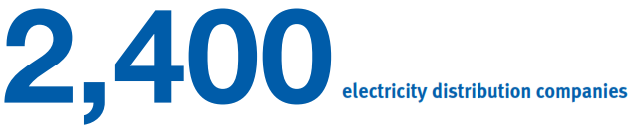
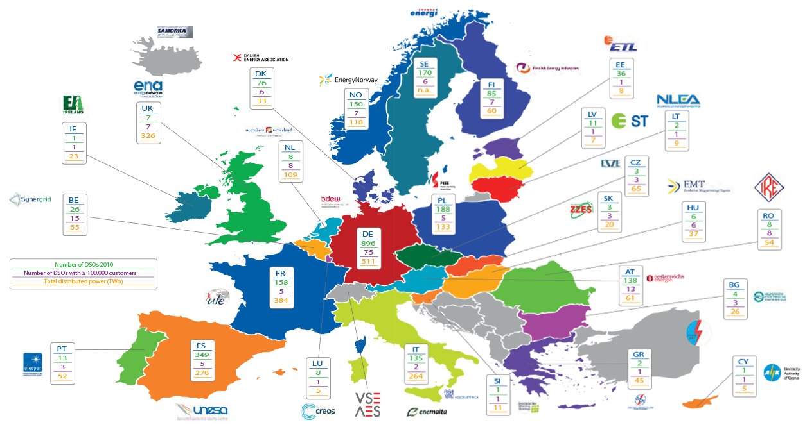
2f Adequate network infrastructure: distribution

Slide 27

2f Adequate network infrastructure: distribution
The share of distribution network investments within overall network investment is expected to rise from 2/3 by 2020 to 4/5 by 2050
Smart metering & smart grids
Replacement
Integration of distributed energy sources
95% of photovoltaics in Europe are connected to distribution grids
DSOs are main investors in smart grids pilots

Slide 28

3. Empower our customers
Transparent bills for customers
Remove regulated prices
Develop a smart market model by 2020
Smart network regulation for cost-effective network investments

Slide 29
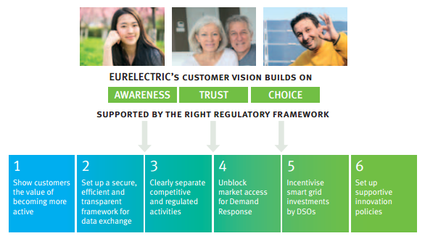
Customers deserve to reap the rewards of taking an active part in the electricity market
SOURCE: EURELECTRIC

Slide 30
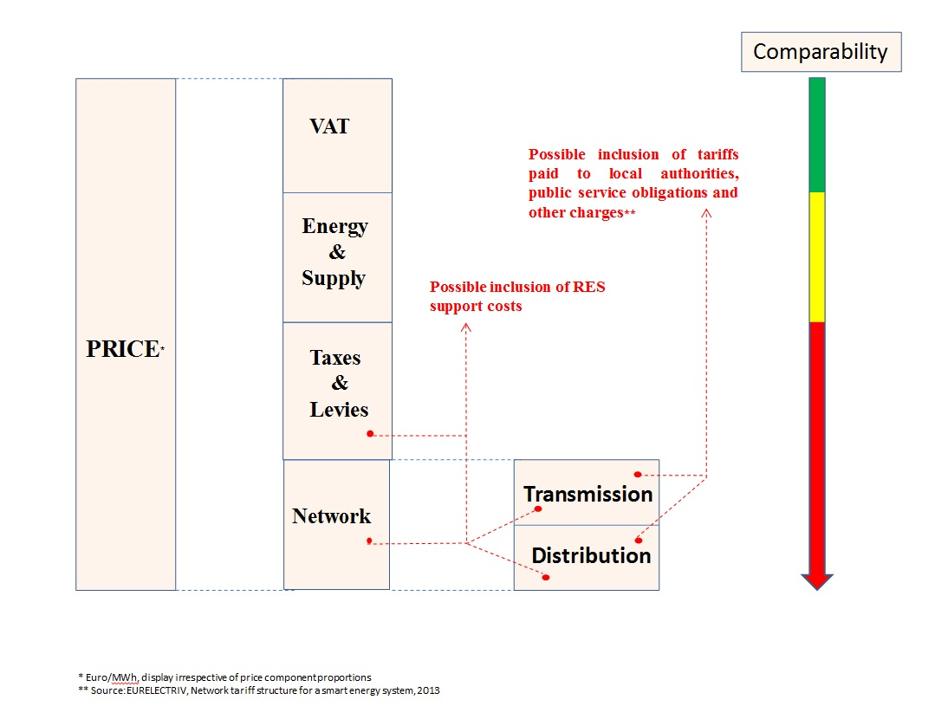
3a Transparent bills for customers
Provide information on the breakdown of cost components
Accompany all new legislative initiatives with a clear analysis of the cost impact for each category of electricity customers
Source: EURELECTRIC
Notes:
As a proportion of the average bill, energy and network charges are decreasing and the add-ons increasing
Market forces only account for less than half the total bill, reducing the scope for energy savings!

Slide 31
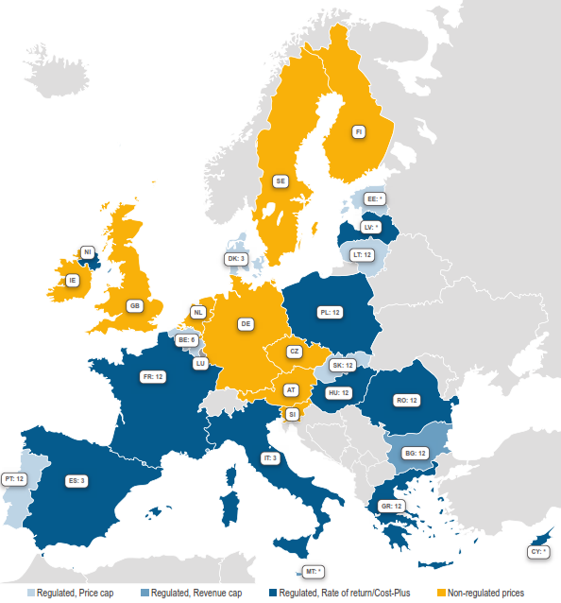
3b Remove regulated prices
Price caps and regulated retail prices still exist in 18 countries
Around 49% of households are supplied under regulated prices
Avoid introducing new restrictions on pricing under the guise of “consumer protection”
Source: ACER Market Monitoring Report 2013

Slide 32
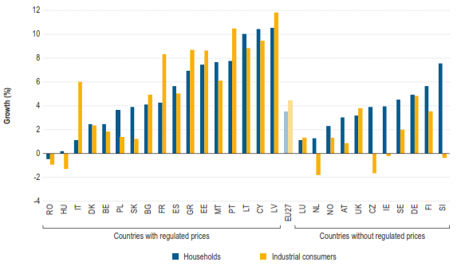
3b Remove regulated prices
On average, retail prices have risen less in countries without price regulation
Source: ACER Market Monitoring Report 2013
Notes:
Show customers the value of becoming more active
Give them incentive to develop customized prices structures, new services
Figure presents the average Post-Tax Total Price growth rate between 2008, the first full year after the liberalisation of retail electricity markets according to the EU law, and 2012.
It shows that average POTP for MSs without price regulation was 1% for industrial consumers and 4% for household consumers. For MSs with price regulation, the change in the POTP was 5% for both household and industrial customers.

Slide 33
3c Develop a smart market model by 2020
Set up a secure, efficient and transparent framework for data exchange for all parties involved with DSOs as market facilitators
Ensure high quality retail market processes (e.g. switching)

Slide 34

3d Smart network regulation for cost-effective network investments
Cost-effective network investments
Cost-reflective network pricing
➔ Incentive for innovation, including smart grids and smart meters
Today, 50-70% of DSO revenue is recovered using volumetric charges (kWh)
➔ Move towards more capacity-based network tariffs (kW)
Notes:
Two sides of the same coin:
Right investment signals for DSOs via regulation
Right signals to consumers via tariffs

Slide 35

The EU should not give up. But it will need to change its tactics
Like in a marathon, there are no shortcuts. Certain steps are indispensable towards reaching this goal
Greater focus is needed on achieving objectives in a cost-efficient way (least costly solutions for customers & taxpayers)
A coordinated European-wide effort is key

Slide 36

Thank You For Your Attention!

